Slide 1


PERROUX GROWTH POLE THEORY
Dr. Tanmoy Dhibor
Assistant Professor
Department of Geography
Hooghly Women’s College

Slide 2
The Growth Pole Theory was developed by French regional economist Francis Perroux in 1955.

Slide 3
He was concerned with the phenomenon of economic development and with the process of structural change.

Slide 4
He attempt to explain how modern process of economic growth deviated from the stationary conceptions of equilibrium growth.

Slide 5
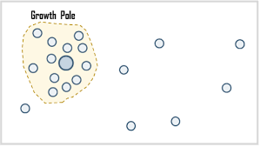
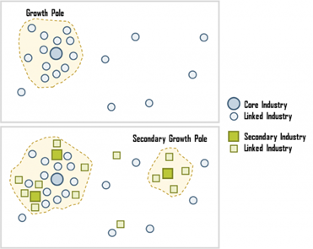

Slide 6
Main Concept:
1. Any growth that place basically occurs towards a specific location which is a result of discontinued growth and location.
2. Growth can be divided on the basis of economic space.
3. Economic space have following characteristics:
a. Homogenous Nature
b. Economic Plan
c. Force which communicate within the element.
4. He considered two basic aspects as base for his theory:
a. Theory of Development
b. Inter-industrial linkage

Slide 7
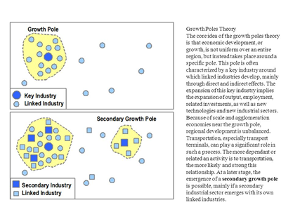

Slide 8
THE GROWTH POLE : 3 BASES
      External Economics
a. Positive
b. Negative

Slide 9
THE GROWTH POLE : 3 BASES
          Agglomerations

Slide 10
THE GROWTH POLE : 3 BASES
          Linkages
a. Forward
b. Backward

Slide 11
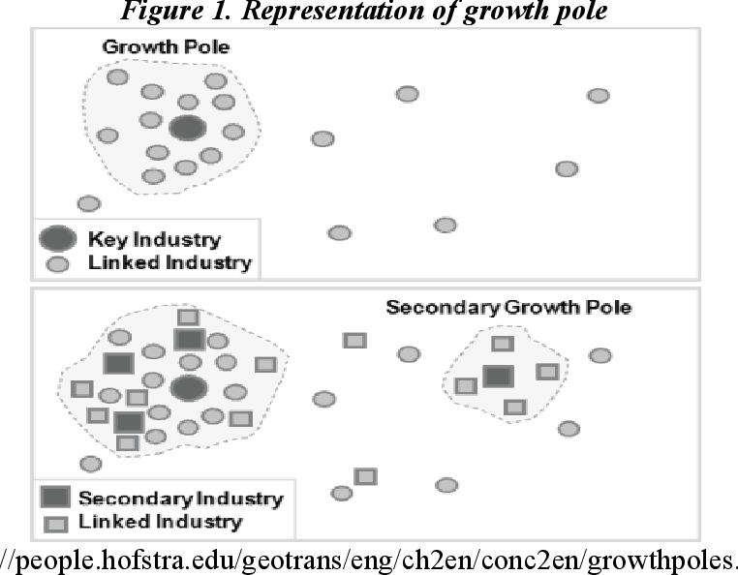

Slide 12
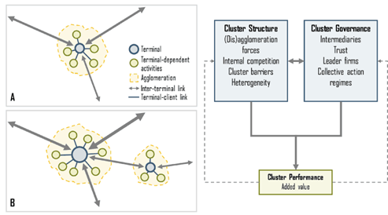

Slide 14
BOUDEVILLES REGIONAL DEVELOPMENT THEORY:
IT IS A MODIFICATION OF PERROUX THEORY.
GEOGRAPHICAL SELEVANCE OF GROWTH POLE THEORY WAS EXPLAINED BY HIM.
According to him, Growth Pole is a propulsive firm ( i. Expanding firm, ii. Dominant firm). He classified economics under 3 heads:
i) Internal to firm.
ii) External to firm & internal to industries.
iii) External to industries but internal to urbanization.

Slide 15
THANK YOU

